Slide 1
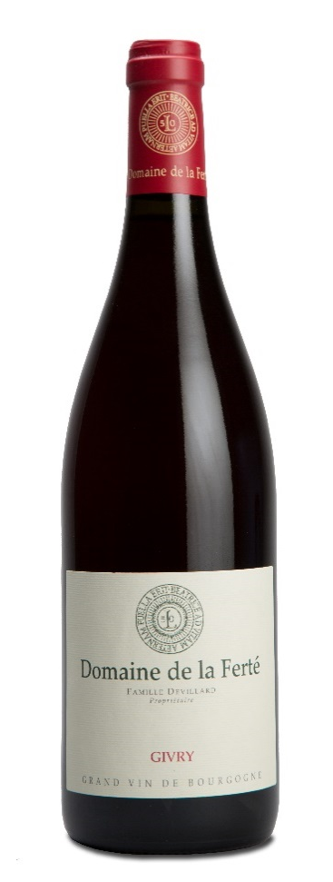
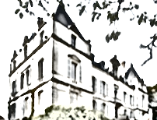
GIVRY
2022
TERROIR
Our plot is called ‘Chanevarie’ and surrounds the famous Premiers Crus ‘Servoisine’ and ‘Cellier aux Moines’. The vines were planted in 1995.
Total area : 1,71 hectares.(4,22 acres)
Climat & Soil : the vineyard is facing South-East and grown on a soil which is rich in clay.
TASTING NOTES
EYE
A deep, brilliant purple-red colour.
NOSE
The nose is generously composed of aromas of blackcurrant buds and small red fruits (raspberry, Morello cherry), followed by spicier notes on opening: pepper, mint, etc.
PALATE
The palate reveals harmonious tannins and fully integrated oak ageing. This balanced, silky wine finishes with a lingering sensation of freshness.
WINEMAKING
To preserve their integrity, grapes are carefully harvested and sorted out by hand.
Both maceration and alcoholic fermentations take place in temperature controlled opened vats for 16 to 18 days. We work with pigeages (punching the cap).
Intensity and numbers are lead to
the concentration of tannins, perfumes and colour.
Alcoholic fermentation is realized with natural yeasts.
SERVICE & CELLARING
It can be served from now at 14-15°C or kept in cellar for 15 years.
AGING
Aging process is taking place
100% in traditional Burgundian
228 liters barrels for 11 months (25% of new oak), followed by 3 months in stainless steel tanks.
We only use French oak coming
mainly from Bourgogne, Allier
and Vosges forests.
Malolactic fermentation is done 100%
FOOD & WINE PAIRINGS
Our Givry Domaine de la Ferté 2022 will perfectly match a fillet of beef with morel mushroom sauce, duck breast with cherries or soft cheeses.
Domaine de la Ferté – BP 5 – 71640 MERCUREY
Tél : +33 (0)3 85 45 86 55
contact@domaines-devillard.com
www.domaine-de-la-ferte.com

